Slide 1
Technological Pedagogical Content Knowledge
(TPCK)

Slide 2
Technological Pedagogical Content Knowledge : A Framework for Teacher Knowledge
Punya Mishra and Matthew J. Koehler

Slide 3
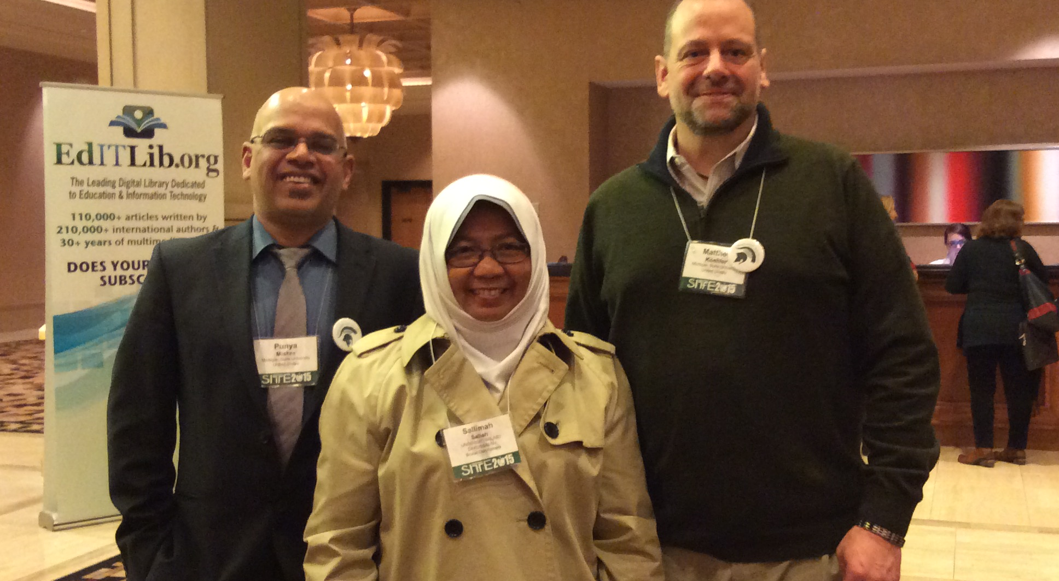
With Punya Mishra and Matthew J. Koehler

Slide 4
What is TPCK?
A framework for teacher knowledge for technology integration into the Pedagogical content knowledge (PCK).
Three bodies of knowledge : content, pedagogy and technology interact (in abstract and in practice) to produce the type of knowledge needed to successfully integrate technology in the classroom.
VIDEO:

Slide 5
The TPCK Framework and component
Content knowledge
Pedagogical knowledge
Technological knowledge
context

Slide 6
Content Knowledge
Content knowledge is knowledge about the actual subject matter that is to be learned or taught.
Knowledge of concepts, theories, ideas, organizational frameworks, knowledge of evidence and proof

Slide 7
Pedagogical knowledge
Pedagogical knowledge is deep knowledge about the processes and practices or methods of teaching and learning and encompasses overall educational purposes, values, and aims.
Knowledge of student learning, classroom management, lesson plan development and implementation, and student evaluation
Requires an understanding of cognitive, social and developmental theories of learning and how to apply to students in the classroom

Slide 8
Technology knowledge
Technology knowledge is always in a state of flux : technology continually changes. Keeping up to date with it a full-time job
E.g digital technology (video, internet, computers, peripheral devices)
Software tools (word processing, email and spreadsheets)
Application (apps), blogs and wikis, podcasting, tagging/social bookmarking
Gaming technologies

Slide 9
Pedagogical Content Knowledge
Knowledge of pedagogy that is applicable to the teaching of specific content
PCK covers the core business of teaching, learning, curriculum assessment, and reporting, such as the conditions that promote learning and links among curriculum assessment, and pedagogy.
PCK is the notion of transformation of the subject matter for teaching

Slide 10
Technological content knowledge
An understanding of the manner in which technology and content influence and constrain one another.
Teachers need to understand which specific technologies are best suited to addressing subject-matter learning in their domains, and how the content dictates or perhaps even changes the technology or vice versa

Slide 11
Technological pedagogical knowledge
An understanding of how teaching and learning changes when particular technologies are used
E.g. web-based technologies such as blogs or podcasts are designed for purposes of entertainment/communication/social networking, teachers need to be creative, open-minded and forward-looking to “reconfigure it” for their own pedagogical purposes

Slide 12
Technological pedagogical content knowledge
An understanding that emerges from an interaction of content, pedagogy and technology knowledge.
TPCK requires teachers as curriculum designers

Slide 13
Goals of the TPCK Course
To develop in Teacher Candidate the strategic thinking involved in TPCK – the thinking that involves PLANNING, ORGANISING, CRITIQUING & ABSTRACTING for specific content, specific student needs, and specific classroom situation.
To guide TC in planning lessons, units and sequences of instructions
To have TC monitor their progress in their development of the KNOWLEDGE, SKILLS & DISPOSITION of TPCK through Reflections: the reflections is a challenge to improve the lesson, the strategies and the assessments.

Slide 14
Strategy to guide TC in the development of TPCK
Collaborative Study Group
Form a group of 3 or 4 TCs according to School level : Primary, Secondary, Voctech, HE
by different content area : Language, Art, Social Studies, Maths, Science, PE

Slide 15
Tasks of the 21st Century Teacher
Teachers of the 21st century must be prepared to redesign and create a curriculum and instruction to prepare their students with the skills of a twenty-first century literate citizen:
New communication and information skills, the ability to think critically and creatively in problem-solving and decision-making situation.
Acquire 21st century learning design 21CLD skills such as KNOWLEDGE BUILDING, USE OF ICT, COLLABORATION, REAL WORLD PROBLEM SOLVING, SELF-REGULATION

Slide 16
Challenges for 21st Century Teacher
Integrating technology with the content and pedagogical issues and concerns.
e.g. elementary pre-service teacher must deal with issues of engaging children in digital story telling (an experience they themselves have not had)
E.g mathematics teachers faced with questions about when and how students should use calculators, or how dynamic spreadsheet can showcase the power of algebra in exploring and making decision about real world problem

Slide 17
Social studies preservice teachers are challenged with developing strategies that guide students to Internet resources in ways that involve a critical analysis of data rather the acceptance without question
Science pre-service teachers must determine whether students learn better with direct experiences (e.g in frog dissection or investigation using a microscope) or whether a technological model or simulation provides the best classroom experience.

Slide 18
ALL TEACHERS are faced with learning to incorporate goals and outcomes beyond their own content areas – guiding students learning about the new and emerging ICT while students are also learning the content with the technology.

Slide 19
Action plan
In order to perform the tasks and overcome the challenges of a 21st century teacher, TC need to learn in gaining Technological Pedagogical Content Knowledge (TPCK) to gain DECLARATIVE, PROCEDURAL, SCHMEATIC AND STRATEGIC ways of knowing and thinking involved in TPCK

Slide 20
The thinking involved in TPCK
Declarative : knowing that
- Definition, terms, facts , description
Procedural : knowing how
- sequences of steps to complete task or subtasks
Schematic : knowing why
- drawing on both declarative and procedural knowledge (such as principles and mental models)
Strategic : knowing when and where
- domain specific knowledge and strategies, e.g. planning and problem solving with monitoring progress toward a goal

Slide 21
TPCK is a way of thinking strategically while involved in planning, organising, critiquing and abstracting for specific content, specific student needs and specific classroom situation concurrently considering the multitude of twenty-first century technologies with potential for supporting students’ learning

Slide 22
GOALS FOR 21ST CENTURY TEACHERS
Understand the diversity of students and their learning needs in a technology-mediated classroom : Individualized learning
Planning and designing learning environments and experiences that meet the diversity of student learning needs in a technologically-mediated classroom
Developing effective instructional strategies to adequately attend to the diversity of students learning needs in a technologically-mediated classroom

Slide 23
GOALS FOR 21ST CENTURY TEACHERS
Identify effective classroom management strategies to support the diversity of students in learning in learning in a technology-mediated classroom
Assessing the diversity of student learning in a technology-mediated classroom, by considering how technology impacts on how students interact with the subject matter.

Slide 24
TASK FOR EACH GROUP
Identify a specific topic you want to plan to teach to a specific group of students (heterogenous group of students in a targeted content area).
Collaboratively identify a specific content topic for the unit of instruction you plan to design

Slide 25
Then initial decision provide the context for exploring important important ideas for
designing lesson/units
Understanding student needs
considering various instruction strategies
Managing classroom activities
Assessing student learning

Slide 26
Matrix organisation of the thinking for designing a unit of instruction
KNOWLEDGE DIMENSION | CONTENT | TEACHING AND STUDENT LEARNING | TECHNOLOGY
DECLARATIVE
PROCEDURAL
SCHEMATIC
STRATEGIC

Slide 27
YOUR TASK AS A GROUP
PREPARE THE MATRIX IN A COLLABORATION DOCUMENT (e.g. iBox, Wiki, document on Google Doc, iCoud, etc)
to dynamically allow each member of the group to work actively on the document

Slide 28
Backward design approach
The following questions help the study group member in clarifying their ideas about the content while carefully considering different knowledge levels (declarative, procedural, schematic, strategic) that distinguish the thinking required in the end-of-the-unit problem or expectation

Slide 29
1) What do you plan for students to do at the conclusion of the unit
2) what problems will these students solve at the end of the unit?
3) what skills will they demonstrate?
4) How will they demonstrate their knowledge of the content (assessment form):

Slide 30
The the group think about teaching and student learning (pedagogy) as well as integrating technology in the unit
Search the Web and investigate other curriculum materials for identifying potential activities, technologies and instructional strategies

Slide 31
KNOWLEDGE DIMENSION | CONTENT
DECLARATIVE | Recognizes that change is the amount to be returned after providing money in excess of the cost of specific items Identifies the value for coins such as cents and dollars
PROCEDURAL | Know how to use “count on” as a means of making change Knows how to use subtraction to find the amount of change
SCHEMATIC | Explains why a set of coins is the least numner of coins needed for returing the excess of the cost of the items
STRATEGIC | Makes change in a lemonade stand simulation Determine money transactions and the appropriate coins needed for returning change for different purchases

Slide 32
Matrix organisation of the thinking for designing a unit of instruction
KNOWLEDGE DIMENSION | TEACHING AND STUDENT LEARNING
DECLARATIVE | Student practice recognizing and comparing values of coins Students engage in multiple experience in counting amounts composed of a variety of coin amounts
PROCEDURAL | Student practice giving change for specific cost Whole class teacher demonstration for making change using “counting on” to determine the excess Worksheets focused on using subtraction to find the change
SCHEMATIC | Small group confirmation to determine multiple ways to return the change Whole class exploration to form conjectures for the number of ways that change could be made for the cost of items
STRATEGIC | Students have opportunities to make decisions about making change: organise groups where each group has a lemonade stand. Each business is a student collaboration for investigating the types of transactions that might occur and the change returned

Slide 33
KNOWLEDGE DIMENSION | TECHNOLOGY
DECLARATIVE | Online flashcards that display sets of coins where students need to count the value of the coins http://www.aplusmath.com/Flashcard
PROCEDURAL | Online money changing game http://www.funbrain.com.cashreg/index Provide exercises with calculators where students enter the total and find the amount to be returned using substrations
SCHEMATIC | Teacher-created spreadsheet that identifies cost of the items, amount tendered and allows the user to determine the change in multiple ways using various types of number of coins
STRATEGIC | Create a movie showing the progress of different businesses in running a lemonade stand to sell different sizes of lemonade, collecting money, and demonstrating different ways to determine the change of specific sale

Slide 34
Twenty-first century Pedagogy

Slide 35
21st century pedagogies
Empower and enable learners
Emphasize learning through relationship
Engage learner in learning communities
Personalise learning

Slide 36
21st century pedagogies facilitate leading through
Project - project based learning
Inquiry - inquiry based learning
Play/games - play-based learning
Nature - naturalist learning
The Arts - art-based leaning
Games - game-based learning

Slide 37
21st century pedagogies facilitate learning by
Collaborating – How will edmodo/evernote/iBox be useful for collaboration?
Creating – How can you use Explain Everything/iBook Maker as a creation tool
Collecting – What are some ways you can use iPad to collect information?

Slide 38
Activities
Social/emotional learning
Peer tutoring
Round table discussion
Student presentation
Independent study
Performance based learning
Team collaboration
Story-telling (floor seating)

Slide 39
activities
Inter-disciplinary learning
Design-based learning
Independent study
One-on-one learning with teacher
Team learning/teaching
Lecture with teacher at centre stage

Slide 40
21st century technology
21st century pedagogies facilitate learning with a range of digital technologies
distance learning
Learning with mobile technology
Internet-based research

Slide 41
Mobile technologies
Phones
Tablets
Application tools

Slide 42
On-line technology
Course, tutorials, Internet searching, distance learning tools

Slide 43
Video technologies
Google hangout, skype, facetime, webinar

Slide 44
Audio technology
podcasting

Slide 45
Computer technology
Software, application and tools

Slide 46
Social media technologies
Facebook, edmodo, twitter, blog, forum, wikis

Slide 47
Other digital technologies
Camera, recorders, peripherals

Slide 48
Modality: Inquiry-base learning
INTRODUCTIO OF THEME
CHALLENGE
EXPLORE
ANALYSE
CONCLUDE

Slide 49
Modality: The Arts
Music
Visual Arts
Movement – dance
Dramatic play / role play
Arts can
engage children’s mind, express their understanding through feelings (e.g. poetry, emotion (what is the colour, what is the smell, what is the sound like)
Develop creativity
Higher order thinking (innovation)
Motivator
Research finding

Slide 50
Modality: Nature
Relate real life experience to what they learn in school
Hands-on/minds-on
Create sustainability
Integration with other subjects
Acquire skills

Slide 51
Modality: Project-Based Learning
Process is more important, rather than an end product
Give time frame
Critical thinking
Communication
Collaboration

Slide 52
In- depth project – 7 steps
A need to know
Driving questions
Students choices
21st century skills
Inquiry and innovation
Feedback and revision
Publicity report products

Slide 53
Modality: Play/Games
Explore
Identify
Engage (play experience)
Active
Games enable mind challenging, peer tutoring, alert, master skills
Benefits: develop social competence, disposition of learning, resilience, empathy; 3Cs (communicate, collaborate, connection); technologically challenging

Slide 54
Questions
How can I manage my pupils in play-based learning?
What are the steps involved in Arts- Based learning
How am I going to assess pupils’ performance using play-based learning>
How can play-based learning and the Art improve pupils’ learning (literacy, numeracy, and critical thinking)

Slide 55
What are the strategies
How about the action plan and the time frame

